Slide 1
SE 361 Sprint #2 Review
Code Monkeys In Tech Support

Slide 2
Sprint Goals
Connect Login and Registration to database
Implement forgot password
Allow users to create tickets
Challenges for Sprint
Busy few weeks with other coursework - all team members

Slide 3
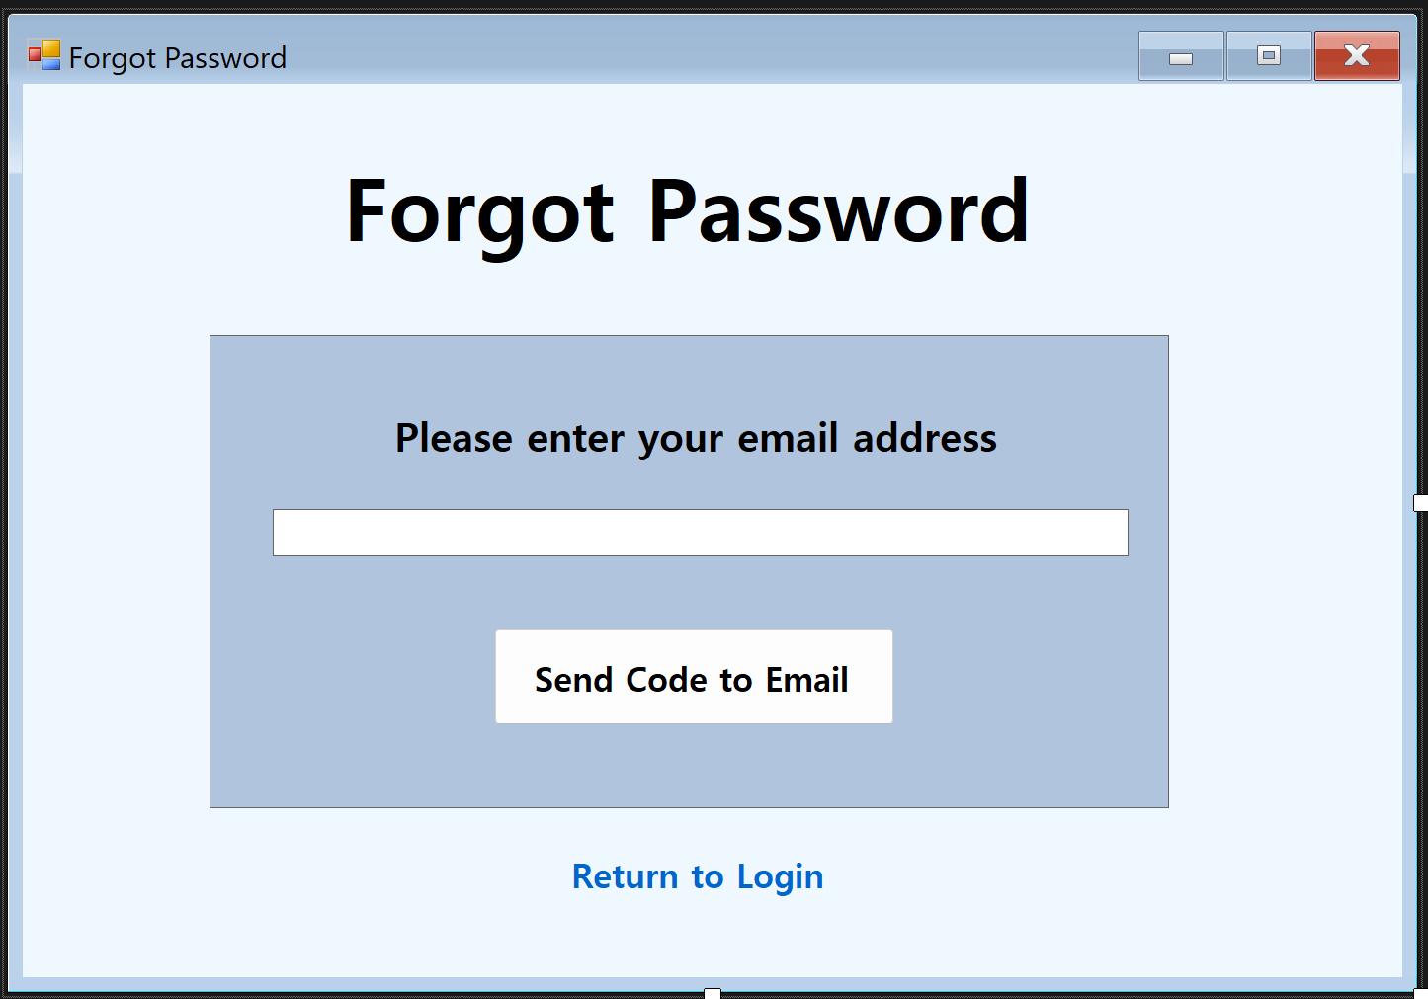
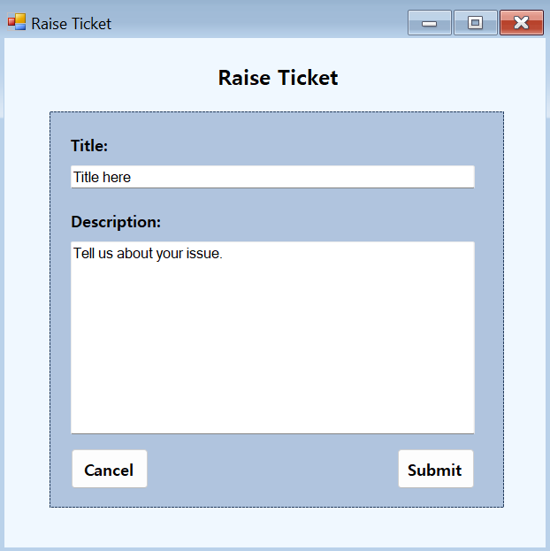
Current design
Created design for Forgot Password and Raise Ticket screens
Not fully functional
Follows design guidelines from other pages
Font
Color Palette
UI

Slide 4
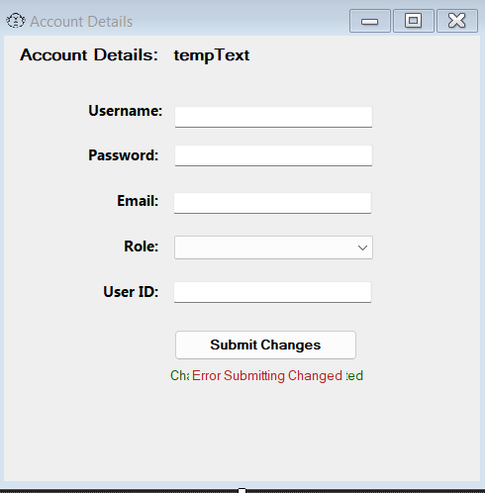
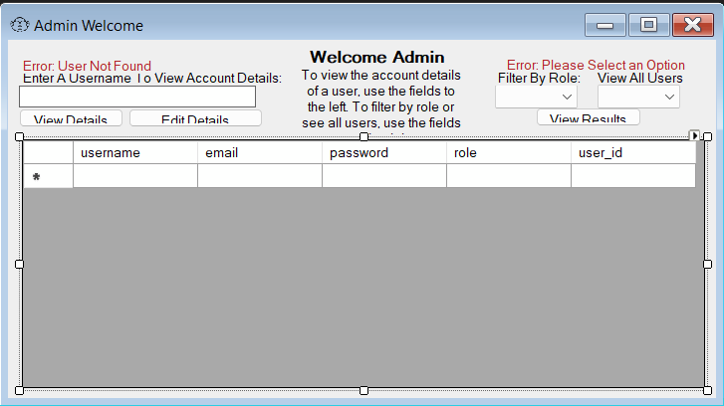
frmViewUsers
frmEditDetails

Slide 5


Slide 6
Current design implementation

Slide 7
Future Goals
Create Ticket object as well as having an interactable GUI for raising a ticket
Get the tickets to save to our database
Implement forgot password functionality
Make the landing page automatically update with user’s active tickets

